Slide 1





FULL STACK DEVELOPMENT
INTERNSHIP AT GRETXP
1 Jan 2024 - 10 June 2024
Submitted By
Abdul Basit Bhat
102003121
4COE-5
Under the guidance of
Industrial Mentor
Mr. Gaurav Kaushal
Product Manager
GretXP
Faculty Mentor
Dr. Mahak Gambhir
Assistant Professor
TIET

Slide 2
Table Of Content
01 - GRETXP OVERVIEW
08 - PROFESSIONAL LEARNINGS
02 - BACKGROUND
09 - HIGHLIGHTS
03 - SCOPE
10 - SOME OBSERVATIONS
04 - PROJECT OVERLOOK
11 - VIDEO
05 - TECHNOLOGIES
12 - FEEDBACK
06 - WORK SNAPSHOTS
07 - TECHNICAL LEARNINGS

Slide 3
GRETXP OVERVIEW
Creates immersive VR experiences for websites.
Targets businesses and 3D creators, offering both user-built and expert-designed solutions.
Focuses on engagement-based interfaces, allowing users to create interactive experiences.
BUILDVR
GretXP's no-code VR website builder.
Integrates virtual showrooms and tours into websites or experiences.
Easy to use, requiring no coding knowledge, making VR development accessible.

Slide 4
BACKGROUND
BuildVR by GretXP: A web and 3D asset creation tool facilitating website development without code, offering a seamless user experience with features like strip-by-strip website building, image/video integration, and immersive 3D experiences.
Comprehensive Website Essentials: Encompasses all essential website elements such as navbars, text areas, buttons, and links, ensuring users can create visually appealing and functional websites effortlessly.
3D Experience Creation Platform: Employs powerful tools leveraging the ThreeJs library to develop and integrate 3D models seamlessly into websites
Technological Internship Opportunity: Internship within the BuildVR team at GretXP, providing hands-on experience in applying academic knowledge to real-world software development scenarios.
Focused Objectives: Internship objectives revolve around enhancing various aspects of the software, including providing Generative AI features, integrating third-party technologies, and developing custom features.
Learning and Growth: Interns engage in structured learning through incremental steps, aimed at reinforcing academic knowledge, understanding development workflows, fostering work ethics etc.

Slide 5
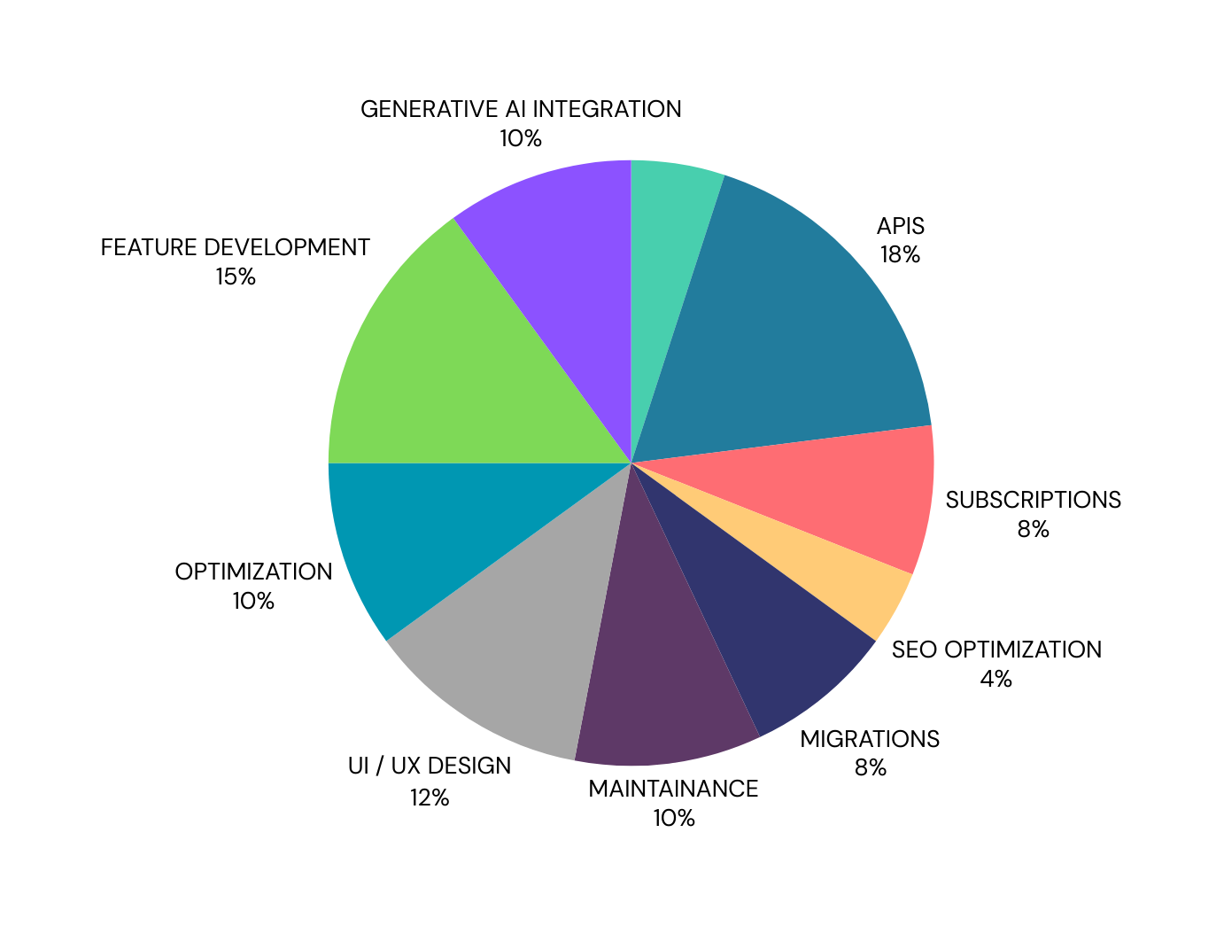
SCOPE OF WORK
GENERATIVE AI
SUBSCRIPTION MANAGEMENT
FEATURE DEVELOPMENT
SCALABILITY
OPTIMIZATION
API DEVELOPMENT
UI / UX DESIGN
SEO OPTIMIZATION
MAINTAINANCE AND BUG FIXES
TECHNOLOGY MIGRATIONS

Slide 6
PROJECT OVERLOOK
Understand Codebase and Workflows
Work under guidance and learn
Research, decide, implement and test
2
4
6
1
3
5
Understand System Architecture
Understand Best Practices Used
Take responsibilities

Slide 7
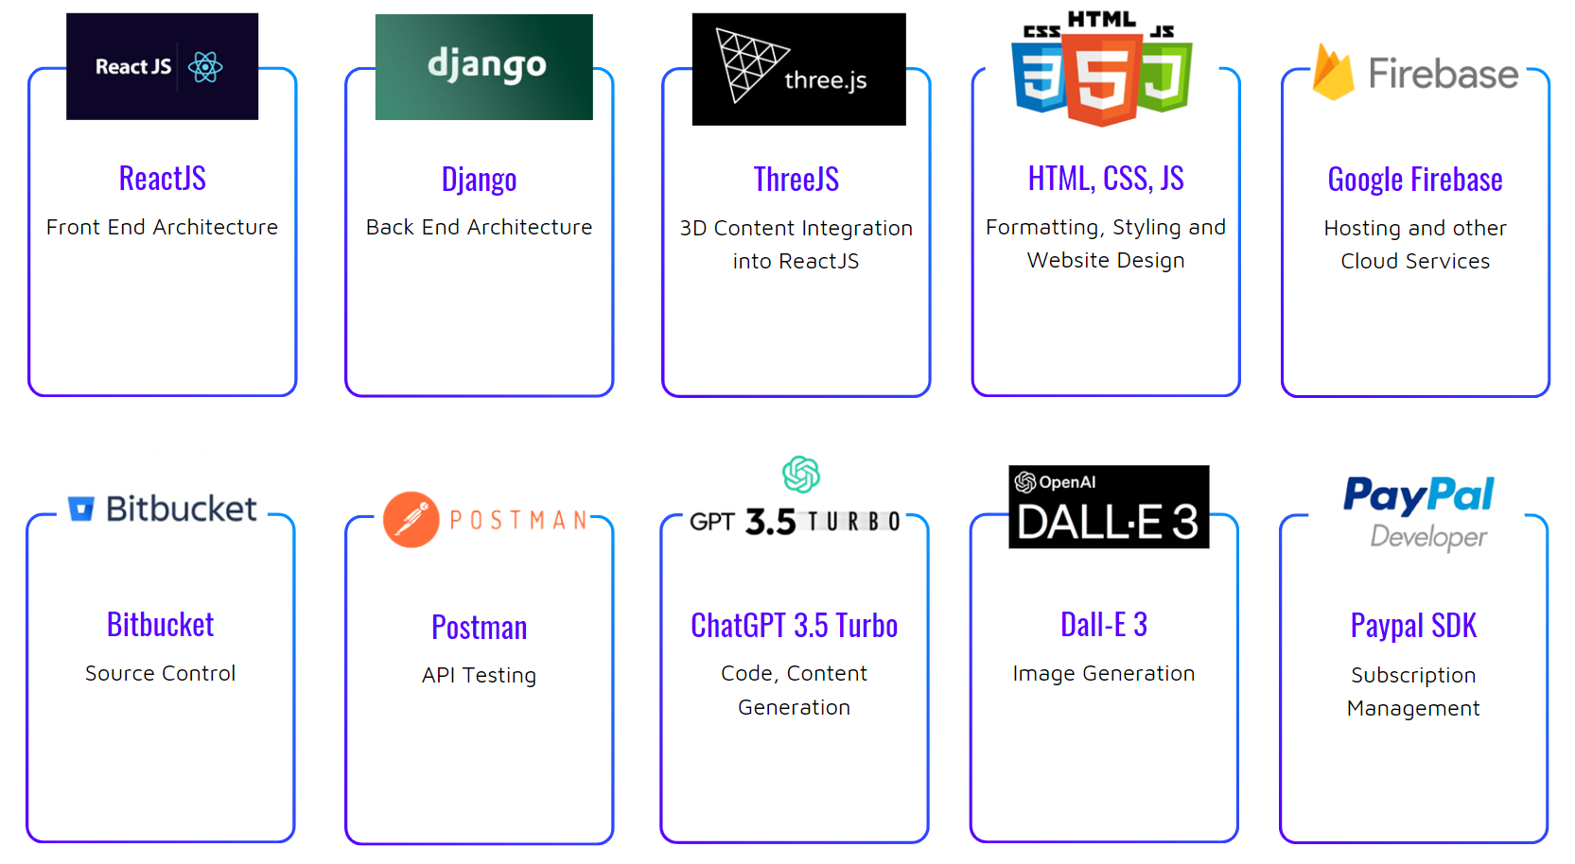
TECHNOLOGIES
02 - WEBSITE
03 - SOCIAL MEDIA
01 - BRANDING
02 - WEBSITE
03 - SOCIAL MEDIA

Slide 8
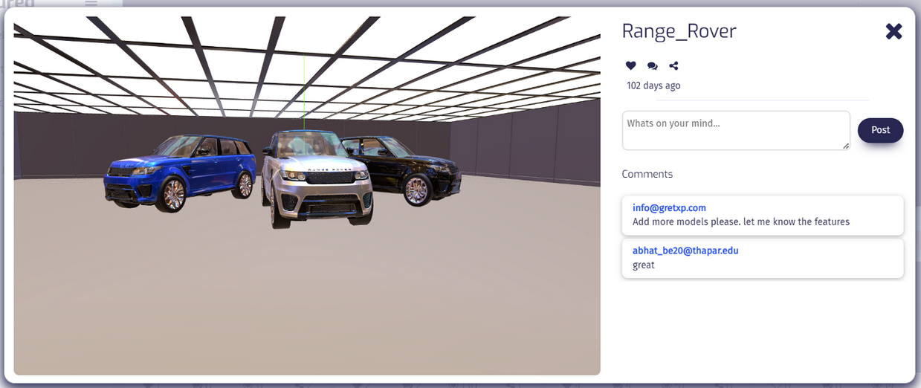
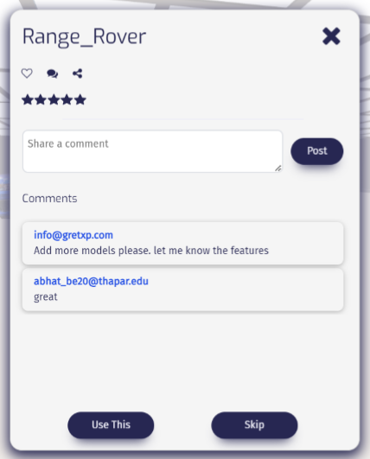
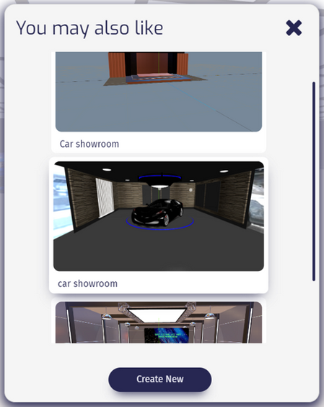
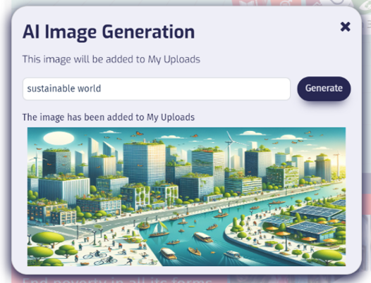
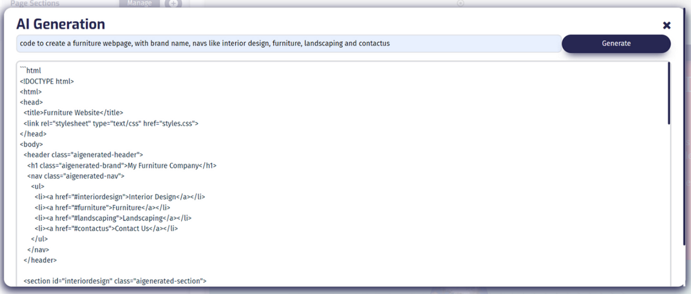
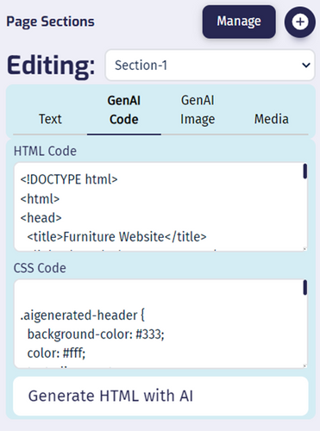
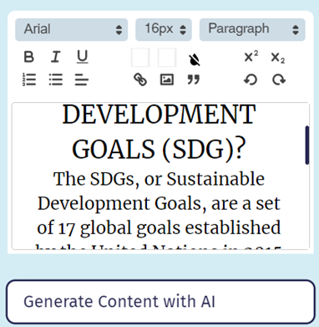
SNAPSHOTS

Slide 9
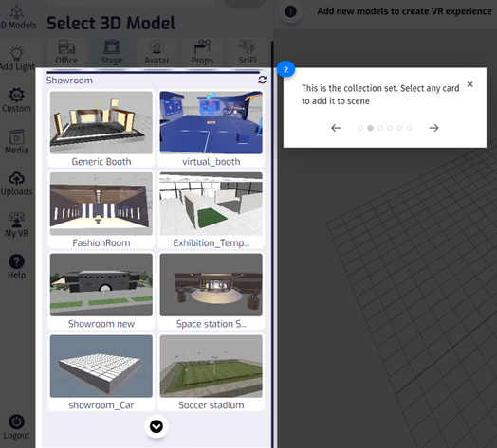
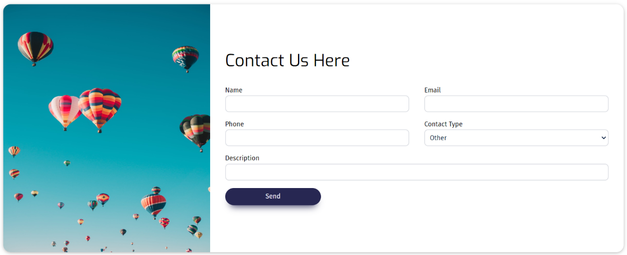
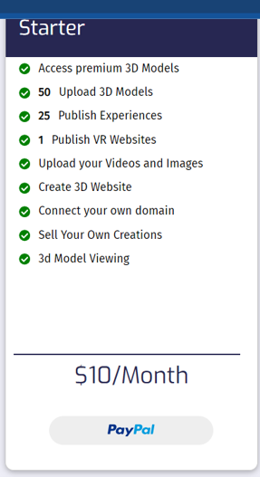
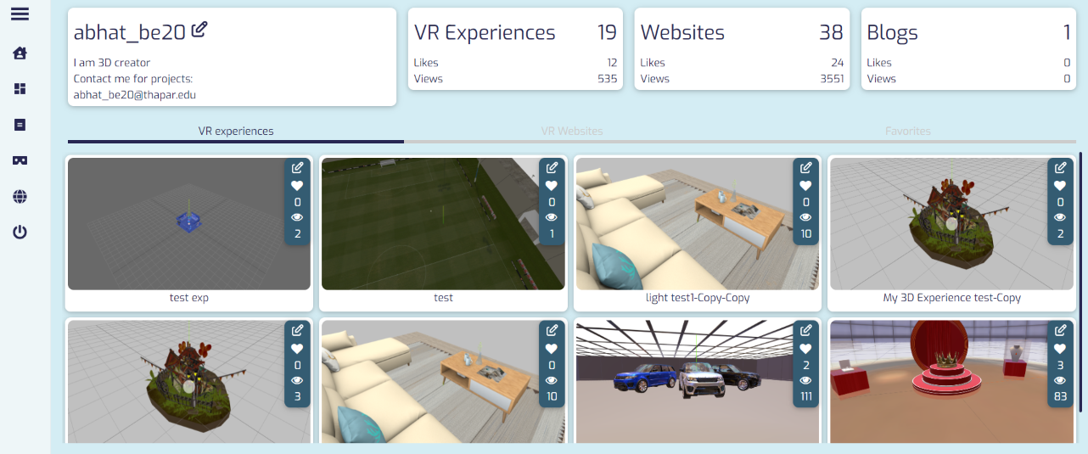
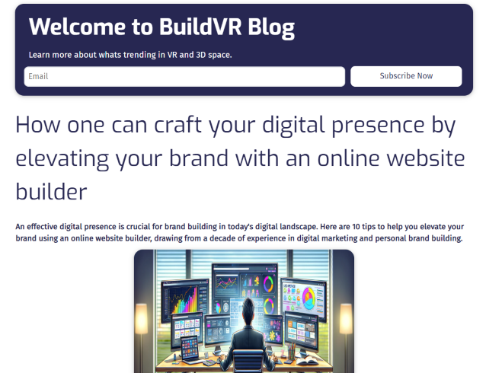
SNAPSHOTS

Slide 10
TECHNICAL LEARNINGS
UI / UX DESING & IMPLEMENTATION
SEO OPTIMIZATION
UI / UX
Designing UI / UX components according to requirements and implementing them using React JS and required frameworks.
SEO
Optimizing system to gain higher indexing crawler ratings. Ensuring speedy operation and utilization of SEO technologies.
API DEVELOPMENT
SYSTEM DESIGN
API
Designing, implementation and testing of application programming interfaces. Optimizing existing APIs and integrating third party APIs into the system.
SYSTEM
Understanding the working of complex system. Getting familiar with best practices used in modern system architecture.
GEN AI INTEGRATION
DEVELOPMENT LIFECYCLE
GEN AI
Using API offering like OpenAI to introduce Generative AI features like text, image and code generation into the system.
DEV
Working of complete feature design lifecycle. Justifying requirements, researching technologies, making trade-offs, implementing and testing.

Slide 11
PROFESSIONAL LEARNINGS
VALUE GENERATING
TIME MANAGEMENT
VALUE
Understand and get able to make trade offs between value of a feature and value of resources used to create it
TIME
Management of time, resources and energy to ensure high quality code and efficiency
PRESENTATION OF WORK
DECISION MAKING
PPT
Presentation of work accomplished, proposals and designs in an engaging way
DECIDE
Develop 360 degree perspective around development workflows and practice calculated decisions.
GEN AI

Slide 12
KEY HIGHLIGHTS
Recognized the significance of third-party offerings in accelerating development cycles and enhancing product value.
Leveraged OpenAI APIs like GPT-3.5 turbo and DALL-E 3 to augment software capabilities.
INSIGHTS INTO MODERN SOFTWARE DEVELOPMENT
Embraced agile and scrum development workflows, facilitating parallel feature development and collaboration.
Utilized source control software for seamless collaboration and version control.
ADOPTION OF AGILE AND
SCRUM METHODOLOGIES
Prioritized security considerations, acknowledging its paramount importance in professional software development.
Emphasized scalability in feature development, ensuring that functionalities could accommodate growing user demands.
FOCUS ON SECURITY AND SCALABILITY

Slide 13
KEY HIGHLIGHTS
Developed complete feature workflows independently, including automatic code, image, and content generation using OpenAI APIs.
Engaged in API development, creating more than 20 APIs and rigorously testing them using tools like Postman.
SUCCESSFUL IMPLEMENTATIONS
Emphasized understanding of codebase, requirements, and best practices to align with the firm's vision.
Enhanced technical skills through documentation, learning new technologies, and staying updated with market trends.
ACHIEVEMENT OF OBJECTIVES THROUGH STRATEGIC METHODS
Promoted clean code practices to enhance code explainability and prevent bottlenecks in collaborative projects.
Ensured code readability to facilitate efficient collaboration and maintenance.
CODE EXPLAINABILITY AND CLEANLINESS

Slide 14
Modern software offerings rely heavily on third party offerings: The development time and maintenance are highly reduced using third party offerings. This leads to quicker feature development lifecycle.
Modern software development follows agile and scrum development: These workflows are highly effective over any conventional workflow. Agile and scrum workflows create a huge impact on the overall product quality, completion rate and user satisfaction.
Source control dominates development workflows: Most of the features are developed in parallel using source control software and collaboration. There is a high value for code cleanliness and explainability. This makes collaboration highly achievable and desirable.
Test servers are highly useful to simulate production level testing: The new features are first deployed on test servers and it undergoes thorough testing on the test production environment. This is due to the reason of features behaving differently on localhost and on cloud technologies.
PATTERNS AND TRENDS OF MODERN SOFTWARE DEVELOPMENT
Security: This concept is the most important for professional software and is at a greater
priority in the checklist of a software. This level of importance is not evident in personal
projects.
Scalability: Features developed in industry level software need to be highly scalable. But in
professional work software features, no matter how powerful, are of no use unless they are
scalable.
Explainability: The code written for professional software are highly explainable in the code itself. The concept of clean code is obvious best practice and much needed for parallel workflow
DEVIATION FROM PREVIOUS EXPERIENCES

Slide 15
VIDEO
Internship Video Link
https://drive.google.com/file/d/1vBb73VID-L_JjMGugNYZ0lVci84UUdrm/view?usp=sharing

Slide 16
FEEDBACK
Thanks to Thapar Institute of Engineering and Technology, Patiala for such a valuable industrial experience.
This experience was a milestone for my professional readiness. The help from industrial and faculty mentor
was a valuable resource. The faculty visits were highly engaging and ensured I was doing well in terms of
learning, understanding and contributing.
Internship is a way of reinforcing academic knowledge and technical knowhow and it was organized in the
best way possible by TIET and GretXP.
Thanks

Slide 17
FULL STACK DEVELOPMENT
INTERNSHIP AT GRETXP
Thanking you all for watching
Thanks to Thapar Institute Of Engineering and Technology , Patiala
for such an opportunity to showcase my work.

